Slide 1
Why is MPI So Slow? Analyzing the Fundamental limits in implementing MPI-3.1
Ken Raffenetti, Abdelhalim Amer, Lena Oden, Charles Archer, Wesley Bland, Hajime Fujita, Yanfei Guo, Tomislav Janjusic, Dmitry Durnov, Michael Blocksome, Min Si, Sangmin Seo, Akhil Langer, Gengbin Zheng, Masamichi Takagi, Paul Coffman, Jithin Jose, Sayantan Sur, Alexander Sannikov, Sergey Oblomov, Michael Chuvelev, Masayuki Hatanaka, Xin Zhao, Paul Fischer, Thilina Rathnayake, Matt Otten, Misun Min, Pavan Balaji
Supercomputing 2017, Denver, CO

Slide 2
Outline
Background
Analyzing the overheads of MPI-3.1 using a highly-optimized implementation
Identifying Shortcomings in the MPI Standard
Application Performance Evaluation
Summary

Slide 3
background
Some complaints about MPI
“MPI is too general”
“MPI is only good for bulk data transfer”
I.e. not small messages
“I wish there was an MPI-lite”
What makes people say these things?
Were there poor design decisions in the MPI library code that lead to poor performance?
Are there limitations to performance imposed by the MPI standard?

Slide 4
Background
An example of MPI generality
int MPI_Isend(void *buf, int count, MPI_Datatype datatype, int source, int tag, MPI_Comm comm, MPI_Request *request);
MPI_Datatype object
Users can provide simple contiguous buffer or complex user-defined datatype
Internally, MPI must check and handle multiple cases

Slide 5
MPI vs. Native
What overhead does MPI add over a native implementation?
Application
Application
MPI
Hardware
Hardware

Slide 6
Background
A highly-optimized MPI implementation
CH4 device layer in MPICH is designed for low overheads
Static inline functions in the communication path allows for high level of compile and link-time optimization
Function arguments “flow through” to the lowest layer

Slide 7
Measuring MPI overhead

Slide 8
Discussion
Instruction count vs. cycle count
Considered both for our analysis
Instructions are easier to understand
Tried to highlight which instructions, such as memory dereference, are more expensive
Receive-side processing
Analysis of MPI_Isend and MPI_Put is a more natural comparison
We observe hardware trends towards message matching offload. In these scenarios, analysis of target-side instructions would largely redundant.
Persistence
It is true that MPI persistent operations can offer run-time optimization, but we posit that compile-time optimization is better.
Single-core performance

Slide 9
BACKGROUND
Measuring software overheads
Using Intel Software Development Emulator (SDE), we traced the instructions generated by MPI from before calling the underlying transport API
From this, we could characterize what MPI was doing, and determine which overheads could be avoided, and which could not.

Slide 10
Instruction Counts of Communication Operations
Notes:
Everything done with static MPI library

Slide 11
Reducing instructions
What were we able to remove?
Error checking ~70 instructions
Argument validation, checking return codes
Thread safety checks ~10 instructions
Are multiple threads calling into the MPI library?
Internal function call overhead ~20 instructions
push/pop stack variables
Runtime checks ~60 instructions
MPI_INT datatype

Slide 12
Microbenchmark Analysis
Message “Issue” Rate
Measures the rate of issuance, disregarding completion operations like MPI_Waitall, MPI_Win_fence
Focus is overhead of MPI_Isend, MPI_Put
We performed three experiments using MPICH/CH4
OFI (PSM2)
UCX (MLNX IB)
“infinitely fast network”

Slide 13
MPICH/CH4 + OFI
Argonne JLSE It Cluster
Intel E5-2699 v4 @ 2.2GHz, Intel Omnipath Interconnect

Slide 14
MPICH/CH4 + UCX
Argonne JLSE Gomez Cluster
Intel E7-8867 v3 @ 2.5GHz, Mellanox ConnectX-4 EDR
*mpich/original uses MXM, not UCX
*MPI_Put values differ in paper

Slide 15
MPICH over an Infinitely fast network
MPI overheads would start showing up on hardware networks that can inject messages at ~35M/s or higher
Going beyond that would require changing the MPI standard

Slide 16
MPI Overheads
Is the MPI standard getting in our way?
Network address virtualization
MPI (communicator, rank) tuple
Often a simple array lookup, but includes expensive memory dereference
Virtual memory addressing
One-sided operations use relative offset to base address
Network hardware uses virtual and physical addresses
Communication isolation
MPI communicators (and windows, files) useful to avoid interference
Created dynamically, ensuring properties must be looked up during communication operations at runtime
MPI_PROC_NULL
Per-operation completion semantics
Each MPI_Isend returns a request object
Match bits for MPI point-to-point operations

Slide 17
Shortcomings IN the MPI standard

Slide 18
Shortcoming #1
Network Address Virtualization with MPI Communicators
MPI (communicator, rank) tuple -> network address
Proposal
Applications would first translate the rank of a peer in a communicator to rank in MPI_COMM_WORLD using MPI_GROUP_TRANSLATE_RANKS
MPI_ISEND_GLOBAL takes global rank, all other parameters remain the same (including communicator argument)
Could save ~10 instructions
MPI_ISEND(…, dest, …, comm)
Translate [dest, comm] to global_rank
Message issuing

Slide 19
Shortcoming #2
Virtual Memory Addressing
One-sided operations use relative offset to base address
Network hardware users virtual and physical addresses
Proposal: MPI_PUT_VIRTUAL_ADDR
Guarantees the implementation does not have to look up window base address
No need to calculate offset from the base address
No need to check window type (dynamic vs. static)
Could save 3-4 instructions
MPI_PUT (…, target_rank, target_disp, …, win)
Calculate network compatible
target_virtual_addr from target_disp, win.base_addr
Message issuing

Slide 20
Shortcoming #3
Communication Isolation with Communicators, Windows, Files
These objects are dynamically created at runtime, and managed by the MPI library.
Proposal: MPI_COMM_DUP_PREDEFINED
Applications take responsibility for communicator creation management
Use predefined handles MPI_COMM_1, MPI_COMM_2, …
Communicator creation routines take these handles as input arguments
MPI then knows at compile-time how many communicators are needed, and can pre-allocate space as global variables
Accesses to the pre-defined communicator array can also be done at compile-time, eliminating a dereference
Could save ~8 instructions

Slide 21
Shortcoming #4
Handling MPI_PROC_NULL
MPI routines must check for MPI_PROC_NULL as input, even if applications never supply it
Proposal: MPI_ISEND_NPN
No branch to check for special value
Saved 2-3 instructions in our implementation
MPI_ISEND(…, dest, …)
(dest == PROC_NULL ?)
YES
return
NO
Message issuing

Slide 22
Shortcoming #5
Per-Operation Completion Semantics
Each nonblocking point-to-point operation returns a request to the user
Proposal: A similar model to one-sided communication, in which operations return no user request
MPI_ISEND_NOREQ
MPI_COMM_WAITALL completes all request-less operations on that communicator
MPI implementations could save allocating/initializing requests, instead using a count-based mechanism for completion.
Could save ~10 instructions

Slide 23
Shortcoming #6
MPI Matching Bits
MPI typically converts src, tag, context_id (comm) to a set of match bits
Proposal: MPI_ISEND_NOMATCH
Remove src and tag from the match bits, leaving only communicator
Semantically, this is equivalent to always using MPI_ANY_TAG, MPI_ANY_SOURCE, but with the benefit that MPI knows this will always be the case (I.e. no need to check comm info hint, or similar)
Could save 5 instructions
When combined with proposal #3, match bits could be constructed with a single load instruction

Slide 24
All together NOW
Combining all our proposals
Implemented MPI_ISEND_ALL_OPTS to combine all proposals
22 instructions remain added over the network layer
66% further improvement over optimized MPICH/CH4 implementation

Slide 25
Minimal MPICH over an Infinitely fast network

Slide 26
Application evaluation

Slide 27
Application Evaluation
Nek5000
High-order spectral element code
Gordon Bell winner
Part of ECP Center for Efficient Exascale Discretizations project
All-MPI implementation that strong-scales to over a million ranks
Experiments use a model problem to solve a linear system using conjugate gradient iteration
Central (long-running) substep in the solution of many simulations
Communication is between nearest-neighbors (halo exchange) using MPI point-to-point

Slide 28
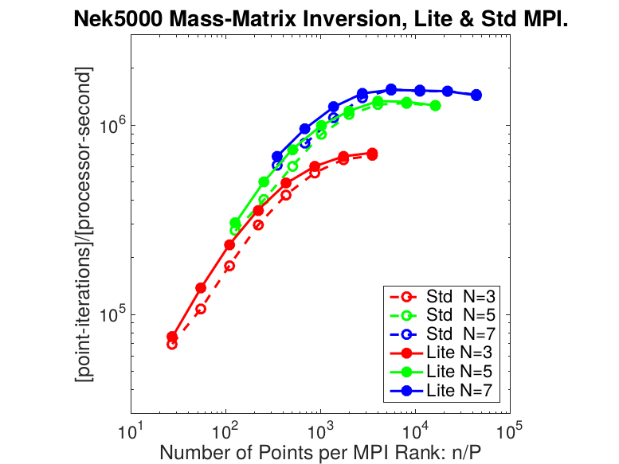
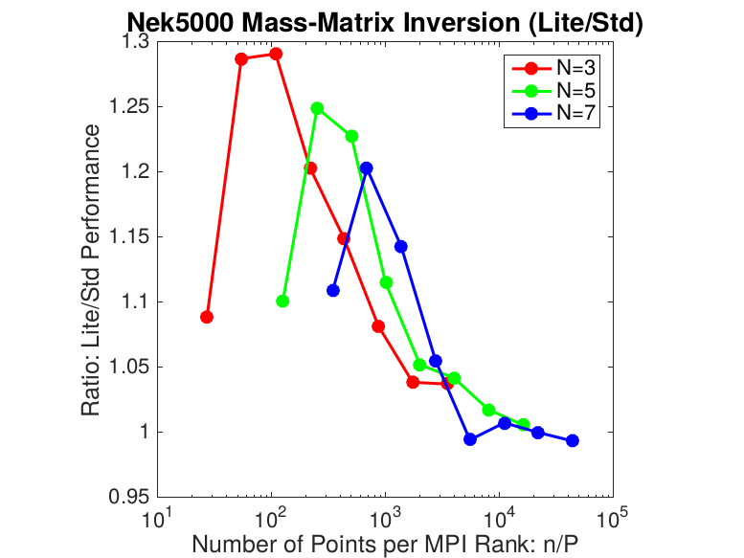
Nek5000 performance
ALCF BG/Q Cetus
512 nodes, 32 ppn all-MPI mode

Slide 29
Application Evaluation
LAMMPS
Molecular dynamics code from Sandia National Labs
3-D spatial decomposition of a given atomic system
MPI point-to-point communication to exchange atomic information with neighbors
Emphasis on strong-scaling for simulations that take large amounts of time
Smaller boxes, less force calculation, more communication

Slide 30
lAMMPS Performance
ALCF BG/Q Cetus
Hybrid MPI/OpenMP 1 rank per core (16ppn), 4 OpenMP threads
Notes:
This simulation was performed on a 3-million=atom face- centered cubic crystal structure for 10,000 timesteps using a simple Leonard-Jones potential.

Slide 31
SUMMARY
MPI overheads can be reduced to just a few tens of instructions through careful design and aggressive compile-time and link-time optimizations
Still, there are unavoidable overheads as defined by the MPI standard
We propose ways to reduce these overheads with new APIs that more closely align with the network hardware APIs MPI is based on
We demonstrate that a lighter weight MPI has value for pushing the strong-scale limit in real applications
MPI does not need to be slow! However, MPI-3.1 limits how fast we can go today.

Slide 32

Acknowledgements
This research was supported by the Exascale Computing Project (17-SC-20-SC), a joint project of the U.S. Department of Energy's Office of Science and National Nuclear Security Administration, responsible for delivering a capable exascale ecosystem, including software, applications, and hardware technology, to support the nation's exascale computing imperative.

Slide 33
THANK YOU!

